Slide 1

Welcome to the Parent/Guardian Education Night on Sleep and School Start Times!
7: 00 - 7: 05 PM Welcome and Introductions
7: 05 - 7: 30 PM Remarks from Panelists
7:30 - 7:50 PM Moderated Questions
7:50 - 8:05 PM Audience Questions
8:05 - 8:10 PM Concluding Remarks and Next Steps

Slide 2
Our Moderator and Panelists
Panelists:
Dr. R. Thomas -- Sleep Medicine Fellowship Director at Beth Israel Deaconess Medical Center and Sleep Center Director, Beth Israel-Needham
Dr. Imad Khan -- Pediatrician with Franklin Pediatric and Adolescent Care
Dr. Eric Tjonahen -- Pediatrician with Pediatric Associates of Norwood and Franklin
Dr. Sara Ahern -- Superintendent of Franklin Public Schools, Communication Coordinator of SSTAC
Moderated by:
Ms. Oona Harrington -- School Start Times Advisory Committee Representative

Slide 3
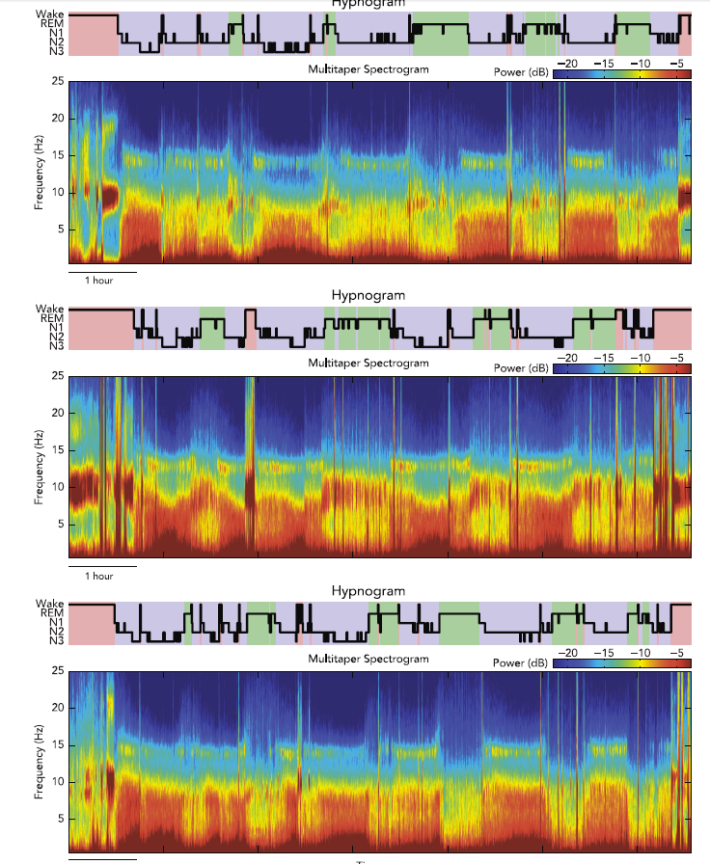
3 healthy subjects - sleep stages and EEG spectral analysis – note the individual spectral “fingerprints”

Slide 4
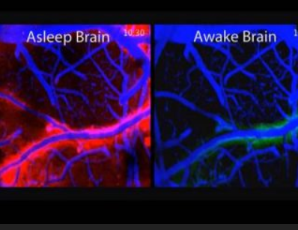
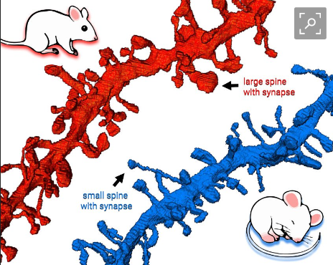
What is sleep doing?

Slide 5
Physiologic Determinants of Sleepiness
Normal Sleepiness
Sleep Drive
Wake Propensity
WORK
SLEEP
Circadian Drive
for Wakefulness
9 am
3 pm
9 pm
3 am
9 am
Awake
Asleep
Adapted from: Kryger MH, et al. Principles and Practices of Sleep Medicine. 2000.
Notes:
SLIDE 16: Physiologic Determinants of Sleepiness
Sleep and wakefulness are regulated by two basic, highly coupled processes operating simultaneously (the "two process" model). These are the homeostatic process(15), which primarily regulates the length and depth of sleep, and endogenous circadian rhythms ("biological time clocks"), which influence the internal organization of sleep and timing and duration of daily sleep/wake cycles.(29)
The circadian sleep rhythm is modulated by the hypothalamus, in particular the suprachiasmatic nucleus (SCN). The SCN sets the biologic body clock to approximately 24 hours, with both light exposure and environmental and scheduling cues entraining or coupling this clock to the 24-hour cycle. Body temperature cycles are also under this circadian hypothalamic control. An increase in body temperature is seen during the course of the day and a decrease is observed during the night. People who are alert late in the evening (i.e., evening types or "night owls") have body temperature peaks late in the evening, while those who find themselves most alert early in the morning (i.e., morning types or "larks") have body temperature peaks early in the evening.
Melatonin has been implicated as a modulator of the effects of light exposure on the circadian sleep-wake cycle. Melatonin is secreted maximally during the night by the pineal gland. Prolactin, testosterone, and growth hormone also demonstrate circadian rhythms, with maximal secretion during the night. Many other physiologic functions, such as urine production and changes in blood pressure, are under circadian control and synchronized with the sleep-wake cycle.
Sleep homeostatic drive (sleep load) builds up during wake, reaching a maximum in the late evening (near usual sleep time). The circadian system facilitates awakening and through the day usually acts as a counterbalance to the progressive accumulation of sleep load. This model explains the ability to maintain wakefulness during the day and sleep during the night. Thus, the relative level of sleepiness or alertness existing at any given time during a 24 hour period is determined by the duration and quality of previous sleep, as well as time awake since the last sleep period, interacting with the 24 hour cyclic pattern or rhythm characterized by clock-dependent periods of maximum sleepiness ("circadian troughs") and maximum alertness ("circadian peaks").
15. Borbely AA, Achermann P. Sleep homeostasis and models of sleep regulation. In: Kryger MH, Roth T, Dement WC, eds. Principles and Practice of Sleep Medicine. 4th ed. Philadelphia, PA: Elsevier/Saunders; 2005:405-17.
29. Czeisler CA, Burton OM, Khalsa SBS. The human circadian timing system and sleep-wake regulation. In: Kryger MH, Roth T, Dement WC, eds. Principles and Practice of Sleep Medicine. 4th ed. Philadelphia, PA: Elsevier/Saunders; 2005:375-94.
Build Slide

Slide 7
Sleep Deprivation Decreases Attention
16
14
12
10
8
6
4
2
0
total sleep deprivation
4 hours nightly
6 hours nightly
8 hours nightly
Attention lapses
BL
2
4
6
8
10
12
14
Days of sleep deprivation
Van Dongen et al, Sleep, 2003
Notes:
7
SLIDE 11: Sleep Deprivation Decreases Attention
With decreased sleep, higher-order cognitive tasks are affected early and disproportionately. Tests requiring both speed and accuracy demonstrate considerably slowed speed before accuracy begins to fail. A dose response experiment measuring waking neurobehavioral and sleep physiological functions during chronic sleep restriction is very revealing.(22) The results demonstrate that chronic restriction of sleep to six hours or less per night produced cognitive deficits equivalent to up to two nights of total sleep deprivation.(22) The experiment further reveals that even relatively moderate sleep restriction can have detrimental affects on waking neurobehavioral functions in healthy adults.
The data shown in this slide clearly demonstrates that sleep deprivation decreases attention. Four different neurobehavioral assays served to measure cognitive performance capability and subjective sleepiness. Each panel displays group averages for subjects in the eight hour (black line), six hour (light blue line) four hour (red line), and total sleep deprivation (yellow line) groups. Chronic sleep period conditions are shown at baseline (BL) and across 14 days. Data shows that chronic restriction of the nocturnal sleep period to either six hours or four hours per day for 14 days resulted in significant cumulative degradation of attention (more lapses) relative to the eight hour sleep period condition.
Decreased behavioral alertness, as measured by lapses of attention, is a dose-dependent, near-linear function of the number of days of sleep restriction.(22) This finding may indicate that the development of neurocognitive deficits over days of sleep restriction may be accounted for solely by cumulative sleep loss. This may further suggest that sleep debt is perhaps best understood as resulting in additional wakefulness that has a neurobiological “cost” that accumulates over time.
22. Van Dongen H, Maislin G, Mullington J, Dinges D. The cumulative cost of additional wakefulness: dose-response effects on neurobehavioral functions and sleep physiology from chronic sleep restriction and total sleep deprivation. Sleep 2003;26(2):117-26.

Slide 8
Recovery Sleep and Attention
Belenky et al, J. Sleep Research, 2003
Notes:
SLIDE 56: Recovery Sleep and Attention
In this study by Belenky and coworkers(83), 66 volunteers spent 14 days in a sleep lab. Baseline (B) records their performance after three nights of at least eight hours in bed. Subjects were then divided into four groups with time in bed varying from nine to three hours per night for seven nights (E). They then were tested for an additional three nights of “recovery” time with eight hours in bed per night (R). Decreasing the amount of time in bed was associated with more lapses. Further, even after several nights of recovery sleep, only the group with nine hours in bed was at baseline. Although the three hour in bed group had the most dramatic increase in lapses during the study, both the three hour and five hour groups had similar high lapse rates in the recovery period. Even the seven hour group, considered perhaps to be a minimal difference in amount of sleep per night, was not at baseline after three nights of recovery sleep, although the performance appeared unchanged compared to the previous few nights. This illustrates how a person may feel that less sleep has no impact, when in fact s/he is not at optimal performance.
83. Belenky G, Wesensten NJ, Thorne DR, et al. Patterns of performance degradation and restoration during sleep restriction and subsequent recovery: a sleep dose-response study. J Sleep Res 2003;12(1):1-12.

Slide 9
School Start Times Advisory Committee (SSTAC)
Established March 2018 to study the prospect of adjusting start times locally
Community, parent, faculty, and student representatives serve on the committee
Subcommittees studying
  Research on Sleep
  After School
  Before School
  Traffic and transportation
  Employee Impacts
  Other Districts
Surveyed parents/guardians and staff
Will report out/ make recommendation to School Committee in spring 2019
Website: https://www.franklinps.net/district/school-start-times-advisory-committee
Did you know? The following schools have adjusted or are adjusting their start times in response to the sleep research:
Sharon (Hockomock)
Easton (Hockomock)
Canton (Hockomock)
Ashland
Holliston
Burlington
Westborough
Several Others...

Slide 10
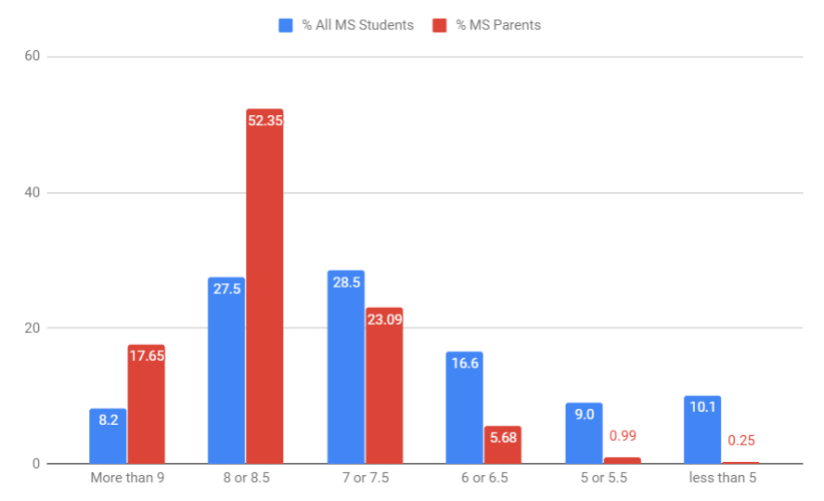
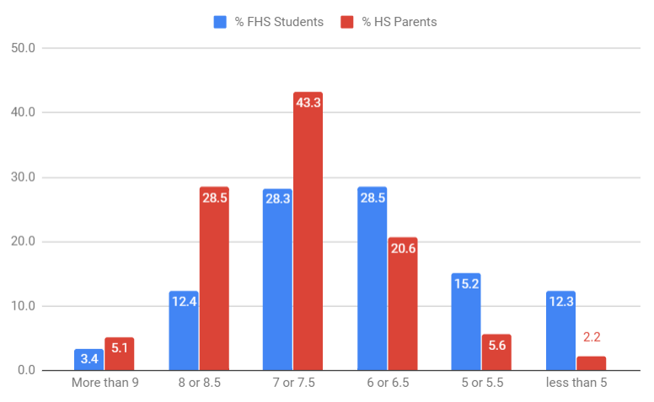
Results of Sleep Question Posed to Parents/Guardians and FPS Students
To students: How many hours of sleep do you usually get on weeknights?
To parents: How many hours of sleep does your child get on weeknights?

Slide 11
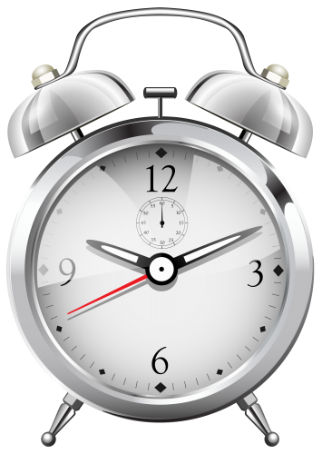
Next Steps...
SSTAC continues survey analysis from nearly 1500 families and over 500 staff members
SSTAC synthesizes information in a report to the School Committee
Scenarios -- as examples only
SSTAC presents report and recommendations to School Committee -- March 26, 2019
Potential School Committee vote (if recommendation is to adjust start times) -- April 23, 2019

